Slide 1
CHAPITER TWO
ACCOUNT, LEDGER AND CHART
OF ACCOUNTS

Slide 2

ACCOUNT

Slide 3
2.0. DEFINITION OF ACCOUNT
The basic summary device of accounting is the account. An account is the detailed record of all the changes that have occurred in an individual asset, liability, or owner’s equity (or stockholders’ equity for a corporation) during a specified period.
Accountants record transactions first in a journal, which is the chronological record of transactions.
Accountants then post (copy) the data to the book of accounts called the ledger. A list of all the ledger accounts and their balances is called a trial balance

Slide 4
Accounts are locations in the accounting system that summarize the increases and decreases in each asset, liability and owner’s equity item appearing on the balance sheet (statement of financial position) and each revenue and expense item appearing on the income statement (statement of comprehensive income).
An account is an element in an accounting system that is used to classify and summarize measurements of business activity.
Briefly, an account is a record of increases and decreases in a specific asset, liability, equity, revenue, or expense item.
Each account has two main parts: Debit (Dr) and Credit (Cr).

Slide 5
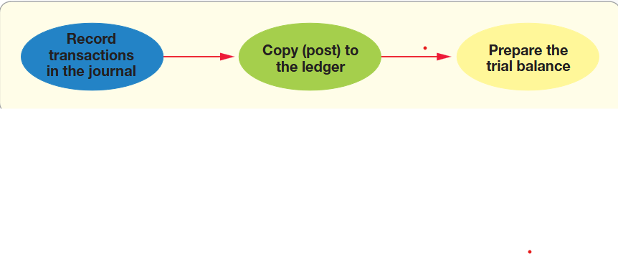
The following diagram summarizes the accounting process covered in this chapter. Take a moment to become familiar with these important terms. You will be using them over and over again.

Slide 6
Account—the detailed record of all the changes that have occurred in a particular asset, liability, or owner’s equity.
● Journal—the chronological record of transactions.
● Ledger—the book holding all the accounts with their balances.
● Trial balance—the list of all the ledger accounts with their balances.
Accounts are grouped in three broad categories, according to the accounting equation and in modern approach:
Assets = Liabilities + Owner’s Equity

Slide 7
ASSETS
CASH
ACCOUNT RECEIVABLE
NOTES RECEIVABLE
PREPAID EXPENSES
LAND
BUILDING
EQUIPMENTS, FURNITURE , FIXTURES

Slide 8
ASSETS
Office Supplies: Items like paper, pens, and other supplies used in daily operations.
Software: Purchased or developed software that is used in business operations.
Inventory: Goods available for sale or raw materials used in production.
Property, Plant, and Equipment (PP&E): Physical assets like buildings, machinery, and vehicles.
Investments: Stocks, bonds, or other securities owned by the business.
Prepaid Expenses: Payments made in advance for services or goods to be received in the future (e.g., insurance).
Intangible Assets: Non-physical assets like patents, trademarks, and goodwill.
CASH: Money in hand or in bank accounts.
ACCOUNT RECEIVABLE: Money owed to the business by customers for goods or services delivered.
LAND: Real estate owned by the business.

Slide 9
LIABILITIES
ACCOUNT PAYABLE
NOTE PAYABLE
ACCRUED LIABILITIES
SALARY PAYABLE
TAX PAYABLE
INTEREST PAYABLE

Slide 10
LIABILITIES
1. Accounts Payable: Money owed by the business to suppliers for goods or
services received.
2. Notes Payable: Written promises to pay a certain amount of money at a future
date, often with interest.
3. Accrued Expenses: Expenses that have been incurred but not yet paid
(e.g., wages payable).
4. Deferred Revenue: Money received in advance for services or goods to be delivered
in the future.
5. Long-term Debt: Loans or bonds payable that are due in more than one year.
6. Short-term Debt: Loans or obligations that are due within one year.
7. Mortgage Payable: A loan secured by real estate, typically paid over a long term.
8. Taxes Payable: Taxes owed to the government that have not yet been paid.
9. Lease Liabilities: Obligations under lease agreements for the use of property
or equipment.
10. Warranty Liabilities: Estimated costs associated with warranty claims on product sold

Slide 11
OWNER’S EQUITY
CAPITAL
DRAWING
REVENUE
EXPENSES

Slide 12
OWNER’S EQUITY
1. Common Stock: Equity capital raised by issuing
shares to investors.
2.Retained Earnings: Profits that have been reinvested
in the business rather than distributed as dividends.
3. Additional Paid-in Capital: Money received from
shareholders above the par value of the stock.
4. Treasury Stock: Shares that were repurchased by the company
and are held in its treasury.

Slide 13
REVENUE
1. Sales Revenue: Income generated from selling goods or services.
2.Service Revenue: Income earned from providing services to customers.
3.Interest Income: Earnings from interest on investments or loans.
4.Rental Income: Revenue earned from leasing property or equipment.
5.Commission Revenue: Income earned from commissions on sales
made on behalf of others.
6.Royalties: Income received from licensing agreements for the use of
intellectual property.

Slide 14
EXPENCES
1. Cost of Goods Sold (COGS): Direct costs attributable to the production of goods
sold by the company.
2. Salaries and Wages: Payments made to employees for their work.
3. Rent Expense: Costs incurred for renting office or retail space.
4. Utilities Expense: Costs for services such as electricity, water, and gas.
5. Depreciation Expenses: The allocation of the cost of tangible assets over their
useful lives.
6. Advertising Expense: Costs associated with promoting the business and its products
or services.
7. Insurance Expense: Premiums paid for various types of insurance coverage.
8. Interest Expense: Costs incurred from borrowing money.
9. Office Supplies Expense: Costs for supplies used in daily operations.
10. Professional Fees: Payments made for services provided by professionals, such as
accountants or consultants.

Slide 15
ASSIGNMENT 3
FIND THE DEFINITION OF EACH OF THE ABOVE ACCOUNTS (MAXIMUM 5 LINES FOR EACH).
USE THE BOOKS SENT TO YOU.
Note : This is individual assignment and clear hand writing is required.

Slide 16
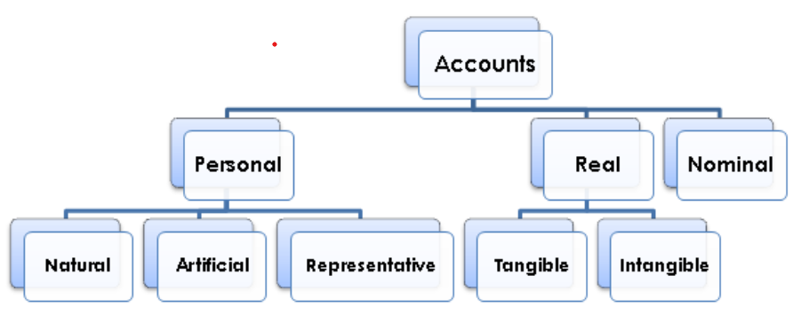
TYPES OF ACCOUNTS
2.2
The Institute of Cost Accountants of India (ICAI),2014 categorized accounts as follow
PERSONAL ACCOUNTS
REAL ACCOUNTS
NOMINAL ACCOUNTS

Slide 17
Personal Accounts
As the name suggests these are accounts related to persons.
These persons could be natural persons like Anie A/C, Bosco A/C……
(b) The persons could also be artificial persons like companies, bodies corporate or association of persons or partnerships etc. Accordingly, we could have Videocon Industries A/c, Infosys Technologies A/c, Charitable Trust A/c, Ali and Sons trading A/c, ABC Bank A/c, etc.
(c) There could be representative personal accounts as well. Although the individual identity of persons related to these is known, the convention is to reflect them as collective accounts.
Ex: when salary is payable to employees, we know how much is payable to each of them, but collectively the account is called as ‘Salary Payable A/c’. Similar examples are rent payable, Insurance prepaid, commission pre-received etc.

Slide 18
REAL ACCOUNTS
These are accounts related to assets or properties or possessions. Depending on their physical existence or otherwise, they are further classified as follows:-
(a) Tangible Real Account – Assets that have physical existence and can be seen, and touched.
Ex: Machinery A/c, Stock A/c, Cash A/c, Vehicle A/c, and the like.
(b) Intangible Real Account – These represent possession of properties that have no physical existence but can be measured in terms of money and have value attached to them.
Ex: Goodwill A/c, Trade mark A/c, Patents & Copy Rights A/c, Intellectual Property Rights A/c and the like.

Slide 19
Nominal Account
These accounts are related to expenses or losses and incomes or gains Ex: Salary and Wages A/c, House rent A/c, Travelling Expenses A/c, service revenue A/c, Commission received A/c, Loss by fire A/c etc.

Slide 20
2.3 DIFFERENT FORMS / FORMAT OF ACCOUNT
A T account
T represents a ledger account and it will help to record transactions in Dr and Cr side and finally determine the final Dr or Cr Balance
Dr Title of account Cr

Slide 21
a. Account without balance column (Assets Accounts)
This form of account shows the full information concerning that account and its representation is the following:

Slide 22
Account without balance column (owner’ s Equity and Liabilities Accounts)
This form of account shows the full information concerning that account and its representation is the following:

Slide 23
b. Account with debit and credit married

Slide 24
c. Account with balance column

Slide 25
2.4 THE ACCOUNT BALANCE
This refers to the difference between the total debits and total credits for an account, including any beginning balance.
DEBIT BALANCE: this occurs when the sum of the debits exceeds the sum of credits
.
CREDIT BALANCE: this occurs when the sum of the credits exceeds the sum of debits.
ZERO BALANCE: this occurs when the sum of both sides of account debits and credits are equal. It means the sum of credits equals the sum of debits of an account.

Slide 26
2.5. BALANCING ACCOUNTS
Balancing accounts involves the following process:
1. Total up the amounts on the debit and credit sides;
2. Compare the two totals, and find out the difference;
3. The difference between the two totals is placed on the side with lesser total and called balance carried forward (balance c/f) or balance carried down (balance c/d) and this closes the current period (has the ending period date). So now both debit and credit totals equal each other.
4. Then the totals of both debit and credit are shown after underlining the last amounts on the same row. The total is then underlined with double lines;

Slide 27
5. The balance c/f amount is then placed below the totals but on the opposite side (if it was on the debit, then placed on the credit and vice versa). This balance is then now known as the balance brought forward (balance b/f) or balance brought down (balance b/d) to start of the following period (has the starting period date). This balance, if is on the debit side is a debit balance and if is on the credit side is a credit balance. Notice the way the balance is on the opposite side when it is being carried forward.
• If there is use of balance c/f, it should be used with balance b/f consistently;
• If balance c/d is used then, it should be used with b/d consistently. Make sure this is followed throughout the accounting practice.

Slide 28
Assignment 4
Using other books or other authors please find terminologies describing the types of account and identify similarities or differences

Slide 29
2.6.CHART OF ACCOUNTS
The ledger contains the accounts grouped under these headings:
● Assets, Liabilities, and Owner’s Equity (Balance Sheet).
● Revenues and Expenses ( Income Statement).
Companies use a chart of accounts to list all their accounts along with the account numbers.
Account numbers are just shorthand versions of the account names. One account number equals one account.

Slide 30
A ledger (general ledger) is the complete collection of all the accounts of a company. Accounts are classified into two general groups:
(1) Balance sheet accounts (assets, liabilities, and owner’s equity) and (2) Income statement accounts (revenues and expenses).
A ledger is a complete listing of account titles and account numbers of all the accounts in the ledger is known as the chart of accounts.
A Ledger is a group of accounts or a book or a printout holding all the transactions.
Types of ledgers
Double entry accounts are kept in various types of ledgers described as follows:

Slide 31
Account numbers usually have two or more digits:
Assets are often numbered beginning with 1,
liabilities with 2,
owner’s equity with 3,
revenues with 4,
and expenses with 5.
The second and third digits in an account number indicate where the account fits within the category.

Slide 32
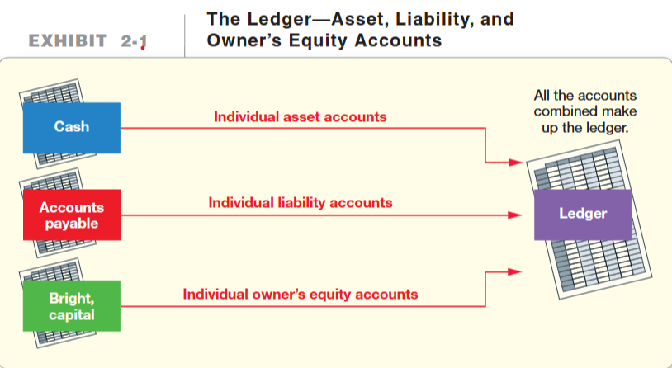

Slide 33
Account numbers, Cash may be account number 101, the first asset account.
Accounts receivable may be account number 111, the second asset.
Accounts payable may be number 201, the first liability. When numbers are used, all accounts are numbered by this system. However, each company chooses its own account numbering system.
Let us see an example here down of Chart of Accounts—
Smart Touch Learning Smart Touch Learning.

Slide 34
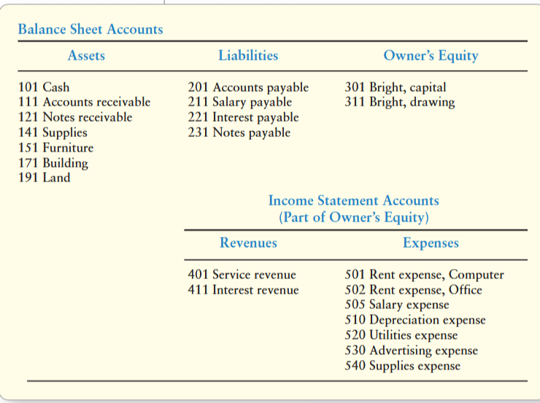

Slide 35
2.7. DEBIT, CREDIT AND DOUBLE ENTRY-ACCOUNTING In accounting, a credit is an entry that increases a liability account or decreases an asset account. A debit is the opposite. It is an entry that increases an asset account or decreases a liability account. In the double-entry accounting system, transactions are recorded in terms of debits and credits.

Slide 36
Accounting is based on transaction data, not on mere whim or opinion. Each business transaction has dual effects:
● The receiving side
● The giving side
Accounting uses the double-entry system, which means that we record the dual
effects of each transaction. As a result, every transaction affects at least two accounts. It would be incomplete to record only the giving side, or only the receiving side, of a transaction.
Consider a cash purchase of supplies. What are the dual effects? A cash purchase of supplies
increases supplies (you received supplies)
decreases cash (you gave cash).
Similarly, a credit purchase of equipment (a purchase on account)
1. increases equipment (you received equipment).
2. increases accounts payable (you gave your promise to pay in the future)

Slide 37

2.8. INCREASES AND DECREASES IN ACCOUNTS
The account category (asset, liability, equity) governs how we record increases and decreases. For any given account, increases are recorded on one side, and decreases are recorded on the opposite side. The following T-accounts provide a summary:

Slide 38
These are the rules of debit and credit. Whether an account is increased or decreased by a debit or a credit depends on the type of account. Debits are not “good” or “bad.” Neither are credits. Debits are not always increases or always decreases—neither are credits.
In a computerized accounting information system, the computer interprets debits and credits as increases or decreases, based on the account type. For example, a computer reads a debit to Cash as an increase, because it is an asset account. The computer reads a debit to Accounts payable as a decrease, because it is a liability
account.

Slide 39
The table below shows how the accounts increase and decrease.
sn | Classification / Types of Accounts | Dr (Debit) | Cr (Credit) | Normal Balance
1 | ASSETS ACCOUNTS | Increase (+) | Decrease (-) | Dr. Balance
2 | LIABILITIES AND OWNER’ EQUITY ACCOUNTS | Decrease (-) | Increase (+) | Cr. Balance
3 | REVENUE / INCOME ACCOUNTS | Decrease(-) | Increase (+) | Cr. Balance
4 | EXPENSES ACCOUNTS | Increase (+) | Decrease (-) | Dr. Balance

Slide 40
2.9. ACCOUNTING EQUATION
It is also known as the balance sheet equation.
AE Assets = Liabilities + Equity.
This equation should be supported by the information on a company's balance sheet.

Slide 41
Liabilities are something the business owes.
For example, a creditor who has loaned money to Smart Touch has a claim to some of the business’s assets until the business pays the debt. Many liabilities have the word payable in their titles. Examples include Accounts payable, Notes payable, and Salary payable.
The owner’s claims to the assets of the business are called equity (also called owner’s, stockholders’, or shareholders’ equity, depending on how the company is organized).

Slide 42
Owner’s equity is affected by:
Capital Invested (+)
Other investments during a period (+)
Withdrawals of the owner (-)
Revenue (service revenue or sales) (+)
Expenses (-)

Slide 43
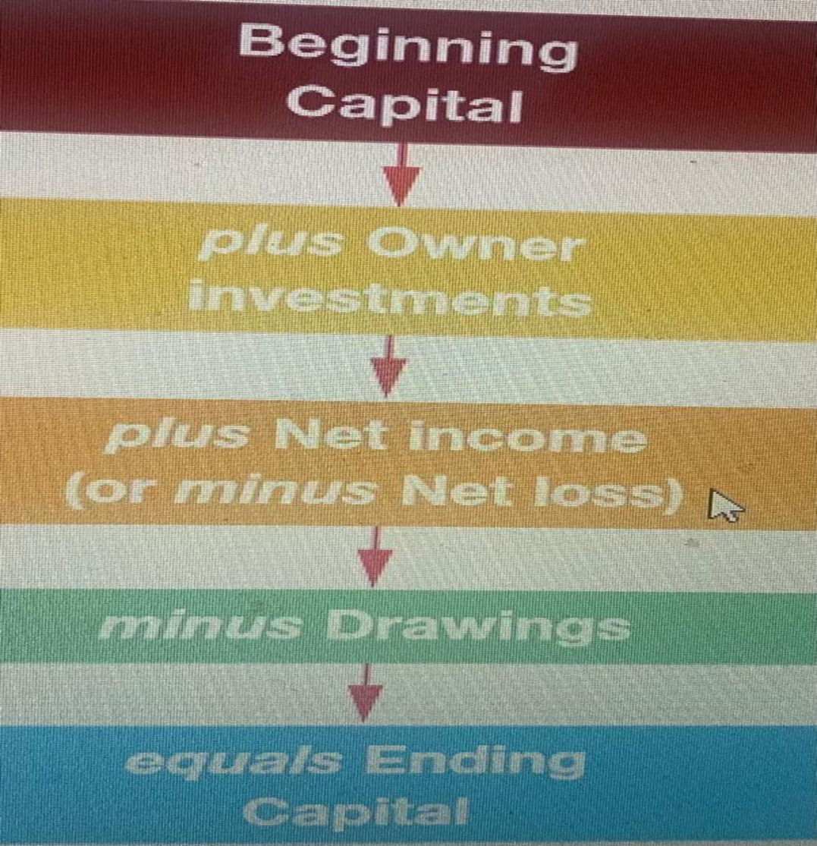
Ending Balance of Owners’ Equity
When we are preparing Owners’ Equity Statement; we use the following formula here.

Slide 44
Equity equals what is owned (assets) minus what is owed (liabilities). It is the company’s net worth. The accounting equation shows how assets, liabilities, and owner’s equity are related.
Assets appear on the left side of the equation, and the liabilities and owner’s equity appear on the right side. The accounting equation is an equation—so the left side of the equation always equals the right side of the equation.

Slide 45
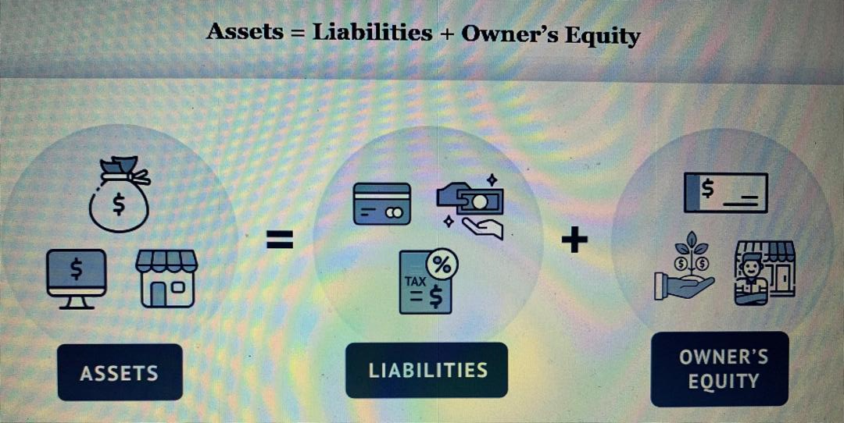

Slide 46
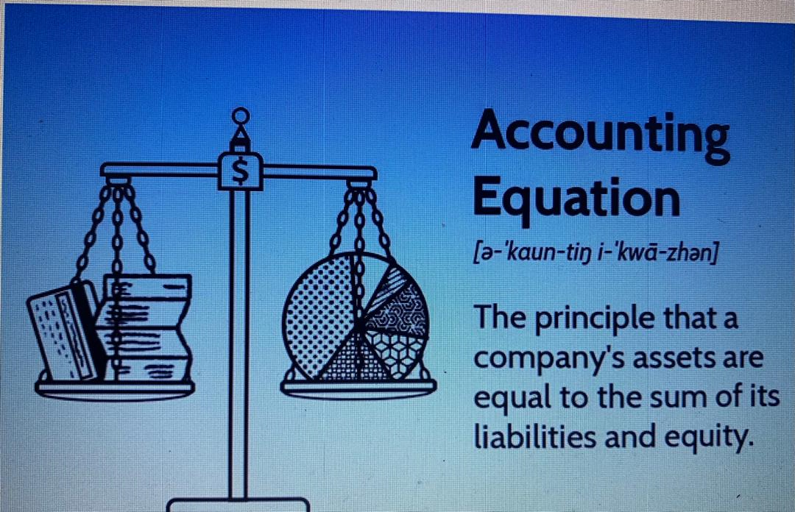

Slide 47
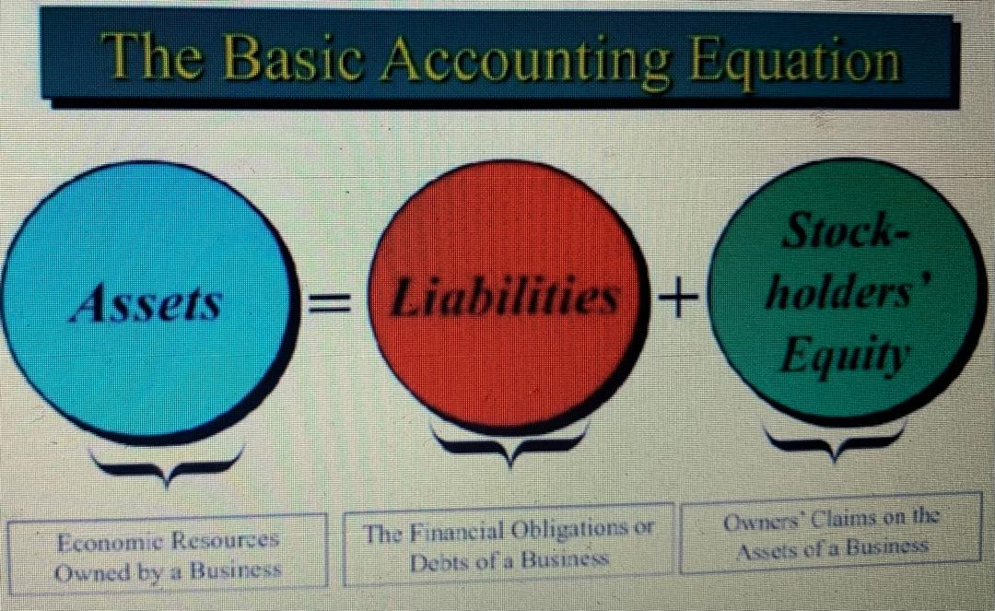

Slide 48
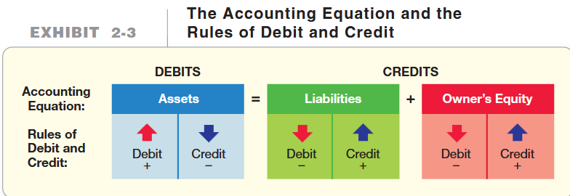
Exhibit 2-3 shows the relationship between the accounting equation and the rules of debit and credit.

Slide 49
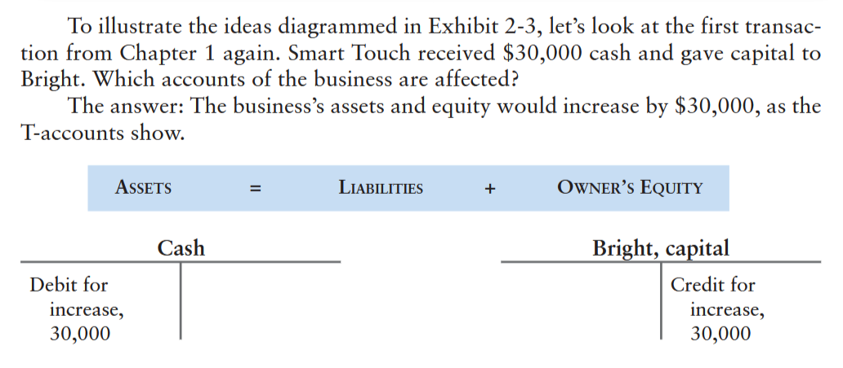

Slide 50
The amount remaining in an account is called its balance. The first transaction gives Cash a $30,000 debit balance and Bright, capital a $30,000 credit balance.
The second transaction is a $20,000 purchase of land. Exhibit 2-4 illustrates
the accounting equation after Smart Touch Learning’s first two transactions. After transaction 2, Cash has a $10,000 debit balance, Land has a debit balance of $20,000, and Bright, capital has a $30,000 credit balance.
We create accounts as needed. The process of creating a new account is called opening the account. For transaction 1, we opened the Cash account and the Bright, capital account. For transaction 2, we opened the Land account.

Slide 51
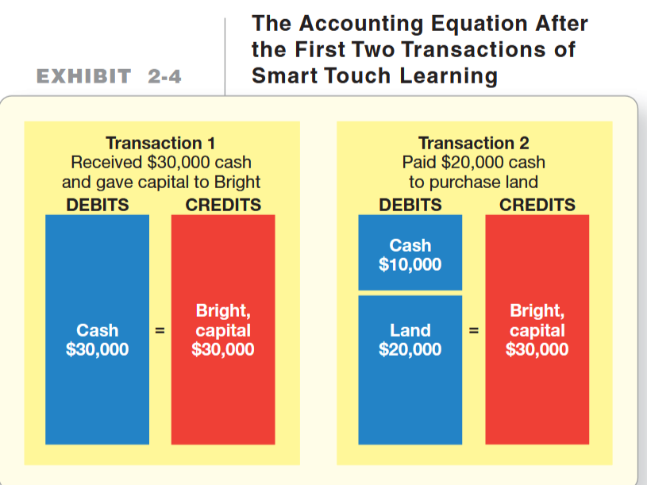

Slide 52
Transaction 1: Starting the Business
Sheena Bright starts the new business as a proprietorship named Smart Touch Learning. In April 2013, the e-learning agency receives $30,000 cash from the owner, Sheena Bright, and the business gave capital to her. The effect of this transaction on the accounting equation of the business is as follows:

Slide 53
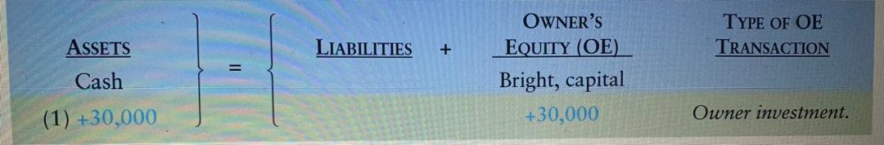

Slide 54
Transaction 2: Purchase of Land
The business purchases land for an office location, paying cash of $20,000. This transaction affects the accounting equation of Smart Touch as follows:

Slide 55
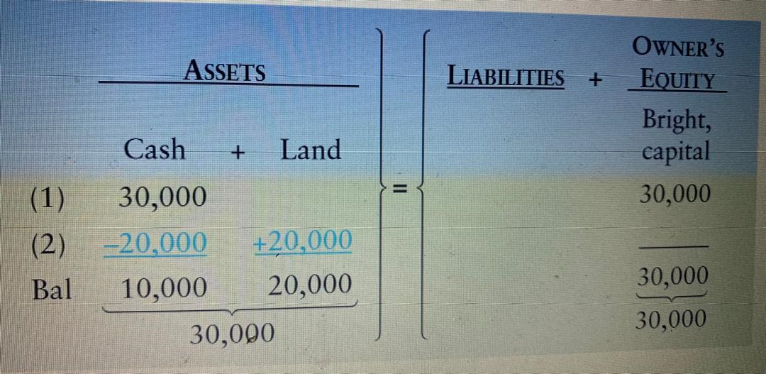

Slide 56
Transaction 3: Purchase of Office Supplies
The e-learning agency buys office supplies on account (credit), agreeing to pay $500 within 30 days. The company will use the supplies in the future, so they are an asset to the business. This transaction increases both the assets and the liabilities of the business, as follows:

Slide 57
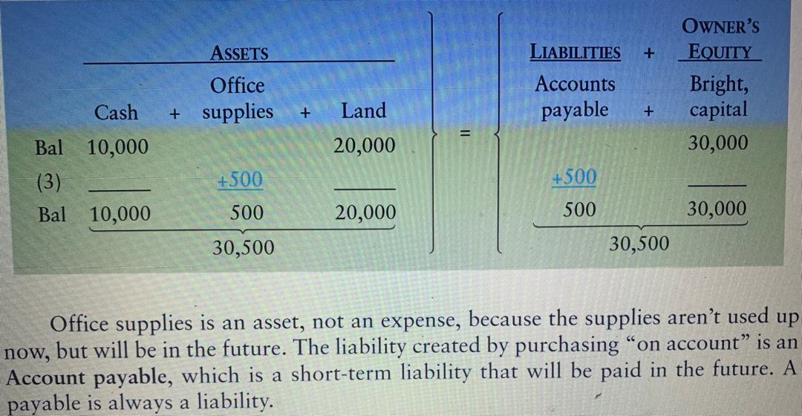

Slide 58
Transaction 4: Earning of Service Revenue
Smart Touch earns service revenue by providing training services for clients. The business earns $5,500 of revenue and collects this amount in cash. The effect on the accounting equation is an increase in Cash and an increase in Bright, capital, as follows:

Slide 59
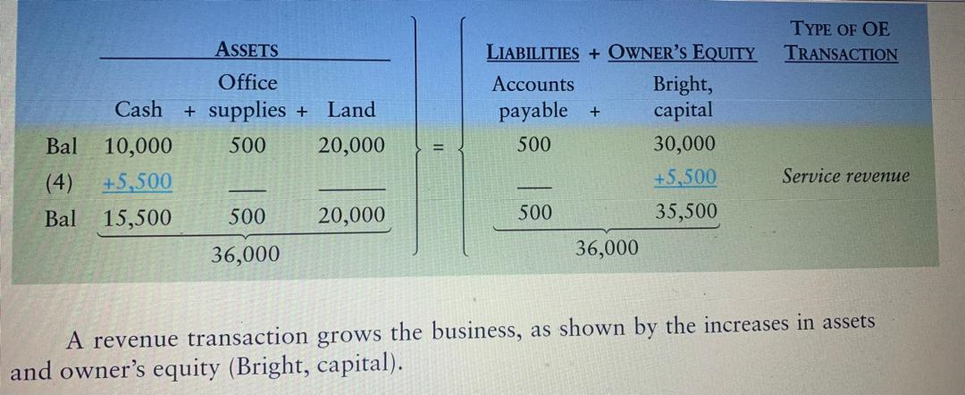

Slide 60
Transaction 5: Earning of Service Revenue on Account
Smart Touch performs a service for clients who do not pay immediately. The business receives the clients’ promise to pay $3,000 within one month. This promise is an asset, an Account receivable, because the agency expects to collect the cash in the future. In accounting, we say that Smart Touch performed this service on account. It is in performing the service (doing the work), not collecting the cash, that the company earns the revenue. As in transaction 4, increasing earnings increases Bright, capital. Smart Touch records the earning of $3,000 of revenue on account, as follows:

Slide 61
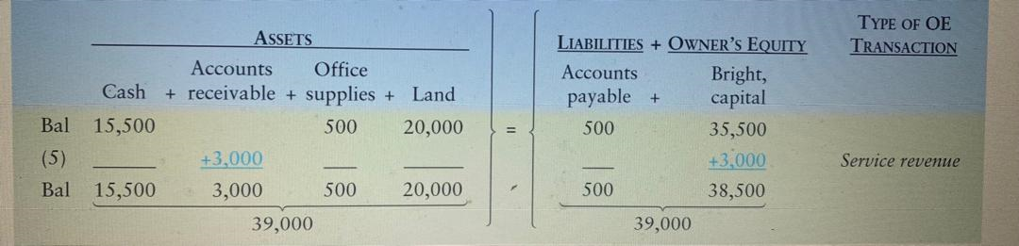

Slide 62
Transaction 6: Payment of Expenses
During the month, the business pays $3,300 in cash expenses: rent expense on a computer, $600; office rent, $1,100; employee salary, $1,200; and utilities, $400.
The effects on the accounting equation are as follows:

Slide 63
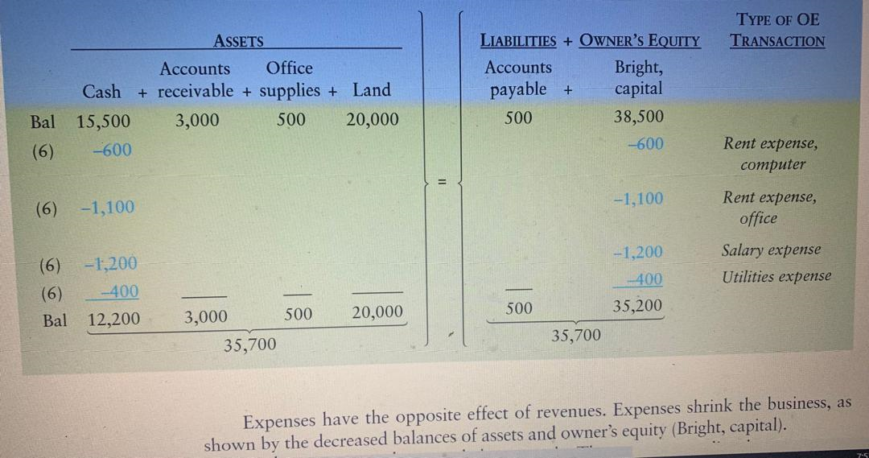

Slide 64
Expenses have the opposite effect of revenues. Expenses shrink the business, as shown by the decreased balances of assets and owner’s equity (Bright, capital).
Each expense can be recorded separately. The expenses are listed as one transaction here for simplicity. We could record the cash payment in a single amount for the sum of the four expenses: $3,300 ($600 + $1,100 + $1,200 + $400). However the expenses are recorded, the accounting equation must balance. (Notice that each side totals to $35,700.)

Slide 65
Transaction 7: Payment on Account
The business pays $300 to the store from which it purchased supplies in transaction 3.
In accounting, we say that the business pays $300 on account. The effect on the accounting equation is a decrease in Cash and a decrease in Accounts payable, as shown here:

Slide 66
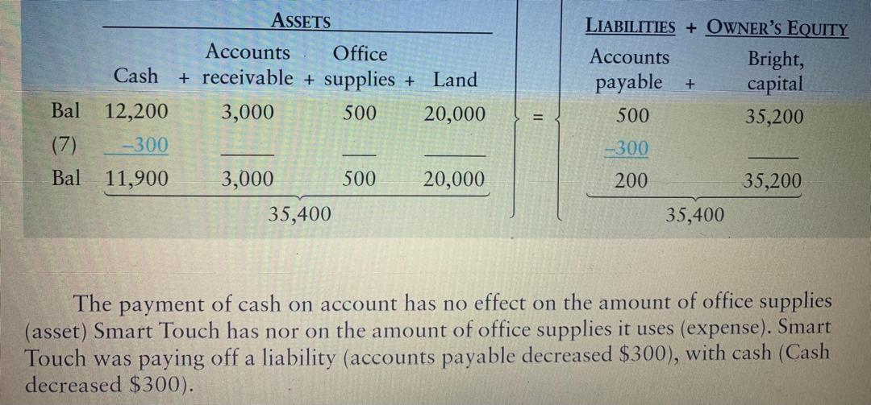

Slide 67
Transaction 8: Personal Transaction
Sheena Bright buys groceries at a cost of $200, paying cash from personal funds. This event is not a transaction of Smart Touch. It has no effect on the e-learning agency and, therefore, is not recorded by the business. It is a transaction of the Sheena Bright personal entity, not the e-learning agency. This transaction illustrates the entity concept.
Transaction 9: Collection on Account
In transaction 5, the business performed services for a client on account. The business now collects $1,000 from the client. We say that Smart Touch collects the cash on account. The business will record an increase in the asset Cash. Should it also record an increase in service revenue? No, because the business already recorded the revenue when it earned the revenue in transaction 5. The phrase “collect cash on account” means to record an increase in Cash and a decrease in Accounts receivable. Accounts receivable is decreased because the $1,000 that the business was to collect at some point in the future is being collected today. The effect on the accounting equation is as follows:

Slide 68
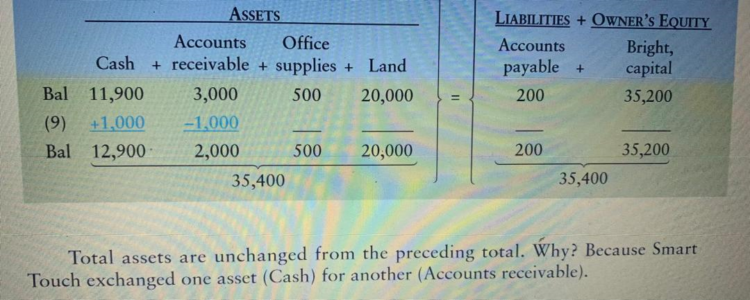

Slide 69
Transaction 10: Sale of Land
The business sells some land owned by the e-learning agency. The sale price of $9,000 is equal to the cost of the land, so Smart Touch didn’t gain or lose anything extra from the land sale. The business receives $9,000 cash, and the effect on the accounting equation follows:

Slide 70
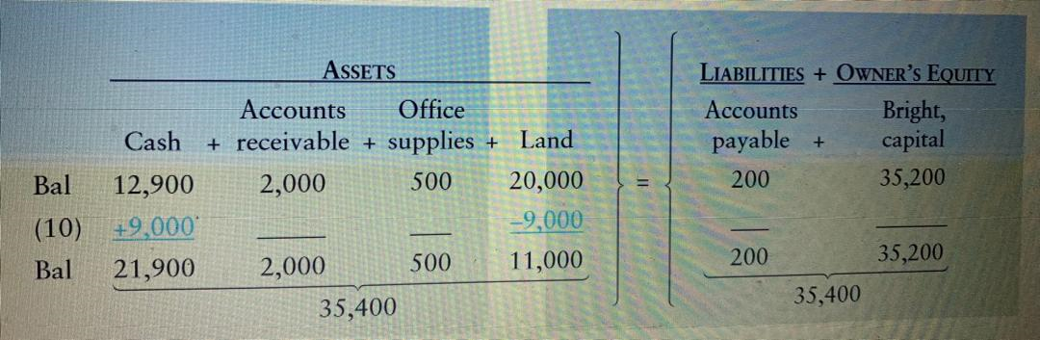

Slide 71
SELF ASSESSMENT

Slide 72
ASSIGNMENT 5
THE TABLE IN WORD HAS A LIST OF ACCOUNTS. USING THE KNOWLEDGE ACQUIRED FROM DEBIT, CREDIT AND BALANCING ACCOUNT, PLZ INCRESE AND DECREASE AS WELL AS BALANCE THEM.

Slide 73
From the above 11 transactions , you are required to make accounting Equation in a full table.
1. The e-learning agency received $30,000 cash and gave capital to Sheena Bright.
2. Paid $20,000 cash for land.
3. Bought $500 of office supplies on account.
4. Received $5,500 cash from clients for service revenue earned.
5. Performed services for clients on account, $3,000.
6. Paid cash expenses: computer rent, $600; office rent, $1,100; employee salary, $1,200; utilities, $400.
7. Paid $300 on the account payable created in transaction 3.
8. Bright buys $200 of groceries. This is not a transaction of the business.
9. Collected $1,000 on the account receivable created in transaction 5.
10. Sold land for cash at its cost of $9,000.
11. Owner withdrew cash of $2,000.

Slide 74
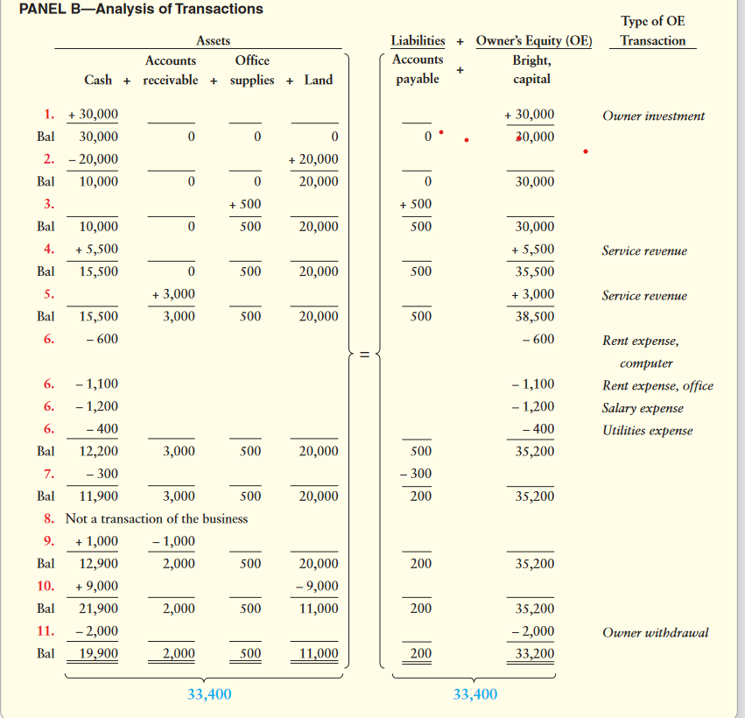

Slide 75
END OF CHAPTER II

